Slide 1
Cash Doctor
Mobile Application 3.0
Team 12
FCR ARB

Slide 2
Team Strengths & Weaknesses
Strengths
Operational: Coordination and Cohesiveness
On time delivery of all documents
Technical: Savvy to new technology
Weaknesses
Operational: Schedules
Communicating over electronic media is difficult
Technical: Proprietary Software usage

Slide 3
Operational Concept Description

Slide 4
System Purpose
Mobile application that provides
The primary purpose of the Cash Doctor Mobile Application 3.0 is empowering consumers with control over the cost and quality of care by sharing pricing and review information of healthcare.

Slide 5
Shared Vision
ASSUMPTIONS Users will share info and provide reviews. Corporations will push their employees to use it via incentives. People will move away from insurance providers if it saves them money. Providers will benefit from using cash. Providers will use the system.
Stakeholders (Who?) | Initiatives (What?) | Value Proposition (Why?) | Beneficiaries (For Whom?)
Developers Cash doctor | Develop the system (for price & review/rating). Market the app/system Corporate marketing strategy. Individual marketing strategy. Provider marketing strategy. | Increase price transparency of health care costs. Increased time and dollar savings for patients and healthcare consumers in general. Empowering the consumer to make a more educated choice about healthcare expenditures Enable consumers/patients to evaluate or provide feedback on healthcare services for community benefit. Revolutionize the industry and profit. | Healthcare consumers - individual and corporate. Health care providers. Cash doctor (includes student team)
Cost |  | Benefits
Development time (in person-hours) Hardware Software Network Maintenance Miscellaneous |  | Consumers and corporations save money Consumers have access to healthcare, information, and networks (intangible) Doctors make more money Usage Registered users Downloads Rate of access Rate of sharing Time saved in finding coverage

Slide 6
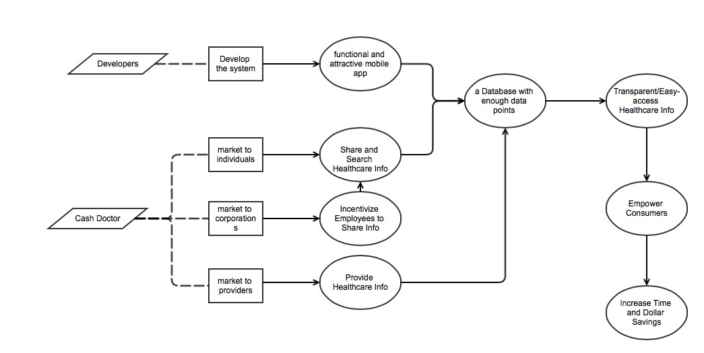
Benefit chain

Slide 7
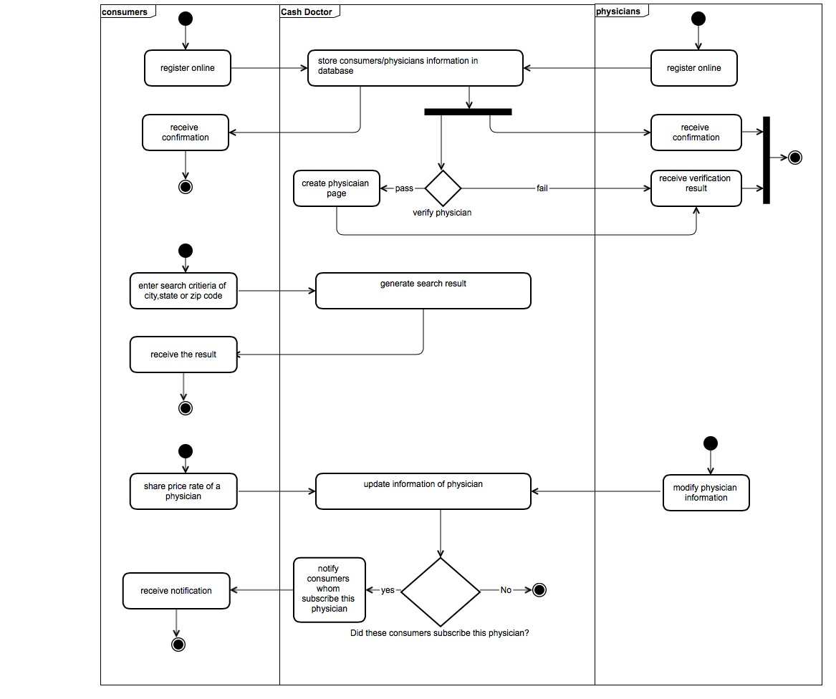
Proposed System – Business Workflow

Slide 8
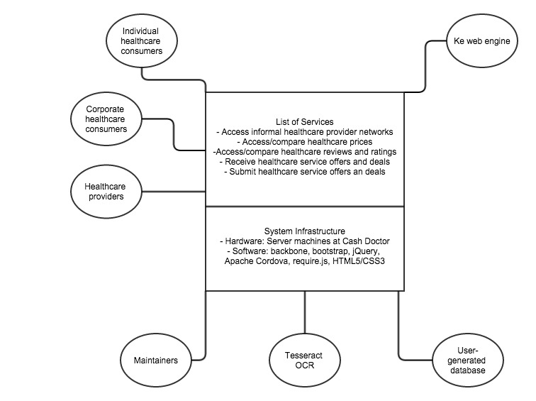
Proposed System - System Boundary

Slide 9
Capability Goals
Capability Goals | Priority Level
OC-1 Manual Information Search: The application should enable consumers to search healthcare information by imputing location, code, price and specialty. | Must have
OC-2 Geo-Location Search: The application should be able to find consumers’ location and show relevant providers around. | Must have
OC-3 Price Comparison: The application should enable consumers to compare price between different providers. | Must have
OC-4 User Registration: The application should enable consumers to register as a user. | Must have
OC-5 Price Sharing: The application should enable users to share healthcare services price by manually imputing or capturing invoice. | Must have
OC-6 Provider Rating: The application should enable users to rate providers and create a review. | Must have
OC-7 Networking: The application should enable users to create a private network and join existing networks. | Must have
OC-7 Profile Management: The application should enable users to create and manage a health profile. | Must have
OC-8 Notification Management: The application should enable users to subscribe form providers to get update notifications. And it also allows users to filter notifications. | Must have

Slide 10
Goals
Level of Service Goals | Priority Level | Referred WinWin Agreements
LOS-1 Number of users: System should be able to support at least 1000 simultaneous users. | Must have | WC_3080
Organizational Goals
OC-1: Increase the price transparency for all healthcare services consumers.
OC-2: Increase sales for Healthcare provider.
OC-3: Reduce costs for corporations who pay healthcare bills for their employees.

Slide 11
Prototype

Slide 12

Personas – Esther Stevenson
Demographic
Age: 63
Occupation: Retired
Hometown: Beverly, MA
Marital Status: Married
Attributes
Often ill
Fixed-income, tight budget
Cares about self- and husband’s health
Scenario
Esther takes the lead, as many women do, in running the healthcare decisions for her family. She lives on a fixed income of her pension and social security, which means money is tight. Given the number of hospital and doctor’s visits per year she and her husband make, she is constantly looking for ways to find more affordable care and would like the opportunity to save money on expensive medications and treatments.

Slide 13

Personas – Harlow LaBarge, M.D.
Demographic
Age: 42
Occupation: Private Practice Doctor
Hometown: Land-O-Lakes, FL
Marital Status: Married
Attributes
Cares about patients, looking to make a connection
Income squeezed by insurance companies
Wants to stay independent
Scenario
Harlow is a private practice physician who is looking for ways to bring in patients and make a personal connection. This is his value-added over large hospital groups that are buying up independent doctors. He would love the chance to broadcast his personality to new patients and existing ones. Given the way insurance companies squeeze doctors, he would also like to be able to make more money per patient visit given that he is a busy man.

Slide 14
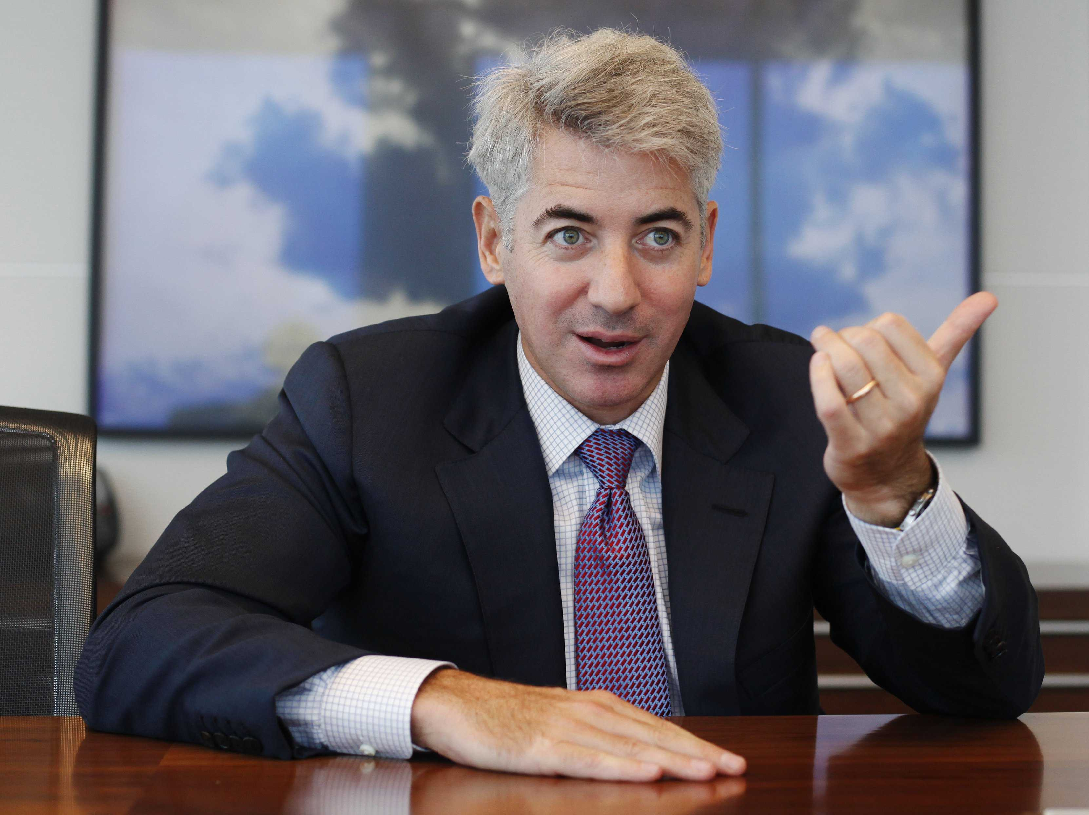
Personas – David Sterling
Demographic
Age: 55
Occupation: CEO
Hometown: Seattle, WA
Marital Status: Married
Attributes
Worried about bottom line
Resistant to layoffs of skilled workers
Likes creative solutions
Scenario
David is to this role and is replacing a CEO who failed to consistently meet investor targets for profit growth. In a low growth world, David is worried about how to increase profits without continuing with layoffs, which are bad for PR. He is open to new and creative ways that he can reduce large costs within the company without much investment.

Slide 15
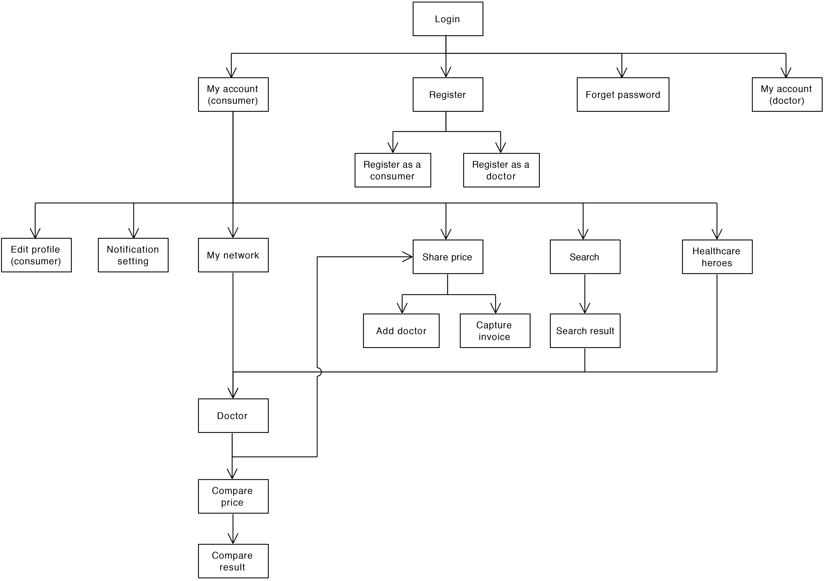
Prototype

Slide 16
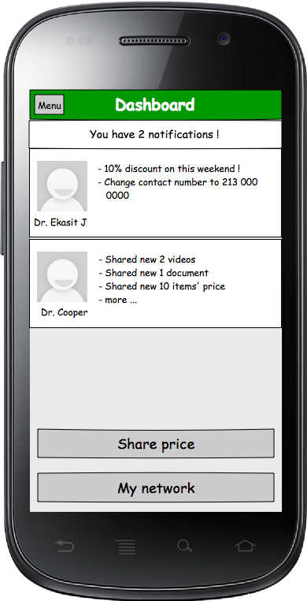
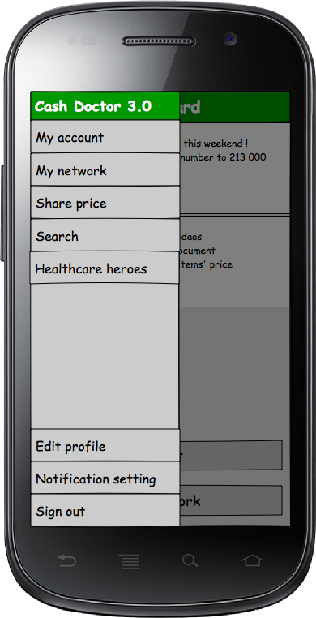
My Accounts Page

Slide 17
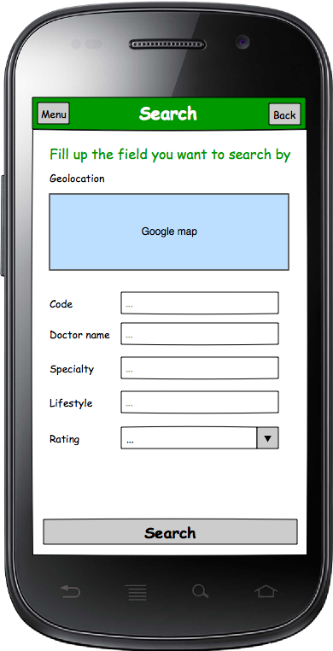
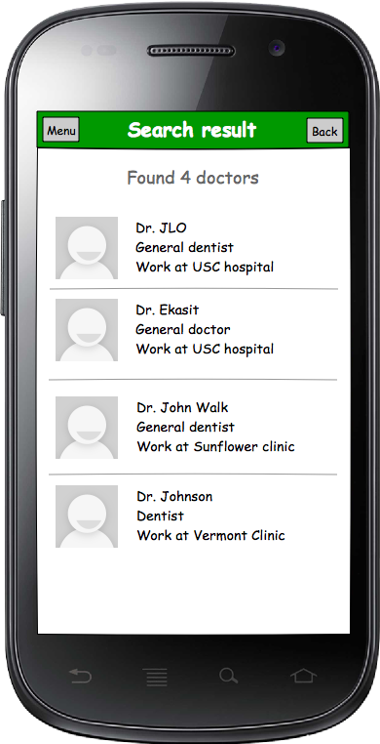
Search Doctor

Slide 18
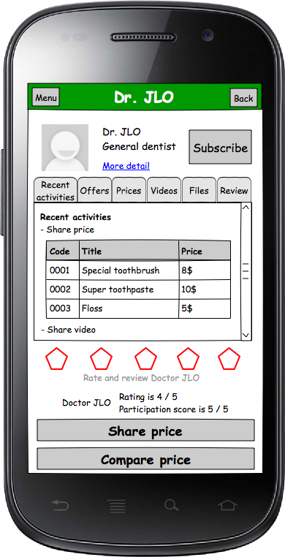
Doctor Profile

Slide 19
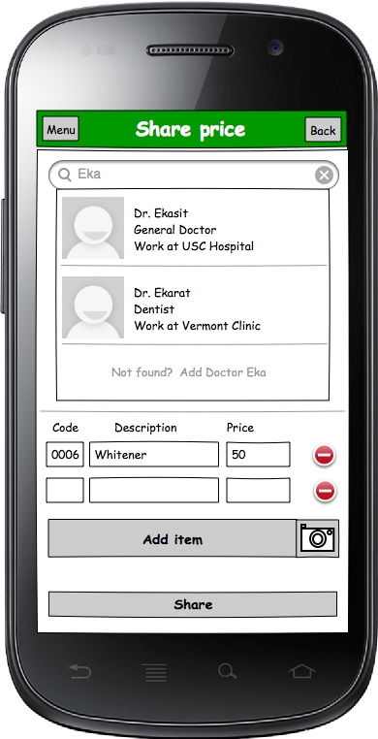
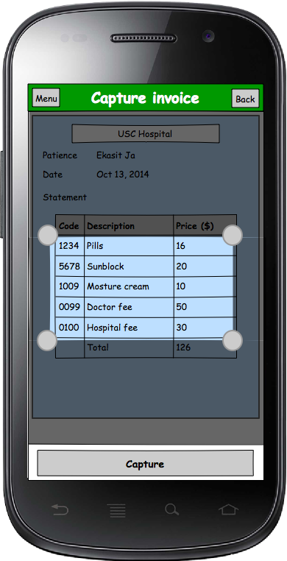
Price Sharing

Slide 20
High-risk feature
WC_3082: An individual consumer can capture an image and code an invoice for sharing
We have 2 Candidates:
Tesseract OCR
Java OCR
Reasons for choosing Tesseract OCR:
1. Train Data already available.
2. Better community.

Slide 21
Tesseract OCR

Slide 22
Demo

Slide 23
REQUIREMENTS

Slide 24
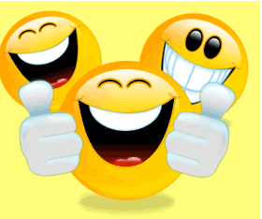

Slide 25
Agreed Win Condition:General
System should be able to support at least 1000 simultaneous users.
System should run on iPhone, Android, and Windows phone.
System should be accurate within a 5 mile radius at a 90% confidence interval.
System must be appealing to the target consumer (80% female).
The system must be easy to use and intuitive by all users.
The system shall integrates with the existing database at Cash Doc.

Slide 26
Agreed Win Condition: User
An industry consumer can manually enter price information for sharing.
As a consumer I can compare healthcare prices.
As a consumer I can create a review of a provider.
As a consumer I can create a private network and join existing networks.
As a consumer I can access my existing account by user ID and password, I can view my existing dashboard.
As a consumer I can register as a user.
A consumer can search for healthcare pricing, provider by location, price, code, specialty.

Slide 27
Agreed Win Conditions: User
As a user, I am able to create a health profile that will attach profile specific offers from providers.
As a user I gain access to features when I share health care pricing.
As a user I can subscribe to notifications so that I have access to relevant up-to-date information.
As a user I can filter notifications I Want to receive relating to the location, price, code, specialty, and provider.
As a user I can find my current location so that I can access relevant providers in and around area (some mile radius).
As a consumer I can rate a provider.

Slide 28
Agreed Win Conditions: Providers
As a provider I can share pricing, offerings, and other content so that I can drive traffic and increase sales.
As a provider I am able to push content to users that is unique to their personal profile.
As a provider I can send offerings to users that are connected to my network so that I drive volume and increase sales.

Slide 29
Agreed Win Conditions: Corporations
As a corporation I can see my employees and the prices they've shared so that can encourage participation.

Slide 30
System and Software Architecture Description

Slide 31
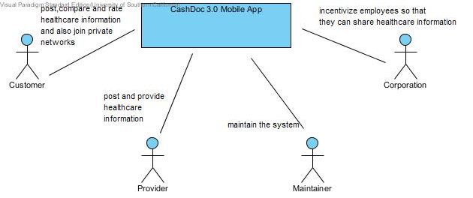
System Context Diagram

Slide 32
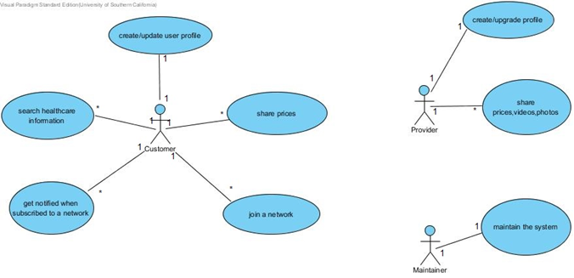
Use Case Diagram

Slide 33
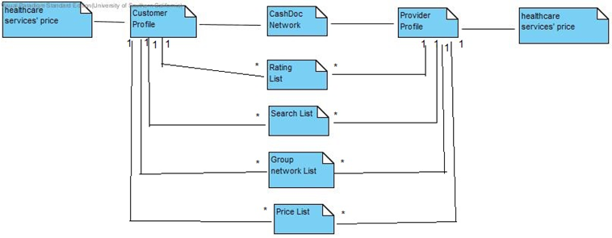
Artifacts and Information Diagram

Slide 34
USE-CASE GRID
ID | NAME | PRIMARY ACTORS
UC1 | Create/Login customer profile | Customer
UC2 | Update customer Profile | Customer
UC3 | Prices shared by the customers | Customer
UC4 | Search healthcare information | Customer
UC5 | Create a network | Customer
UC6 | Join an existing network | Customer
UC7 | Get notified based on the network subscribed for | Customer
UC8 | Create/Login Provider profile | Provider
UC9 | Provider shares Healthcare Information | Provider
UC10 | Maintain the system | Maintainer
UC11 | Customer can rate/review a provider | Customer
UC12 | Customer can compare medical price information | Customer

Slide 35
Create/Login customer profile, Create/Login Provider profile
Identifier | UC1,UC8:Login
Purpose | Determines if a person logging in to the system can be authenticated, and, if so, what the person's privileges are as a user of the system, i.e., what the person is authorized to do when using the system
Requirements | Authorization and Authentication
Development Risks | None
Pre-conditions | CMS database should be initialized
Post-conditions | If customer is authorized s/he is given access to “My accounts” page; otherwise, s/he is denied access to the system.
Typical Course of Action: Login-Successful
Alternate Course of Action: Login-New Account
Alternate Course of Action: Login-Failure
Alternate Course of Action:Login:Forgotten Password

Slide 36
Update Customer Profile
Identifier | UC2
Purpose | To provide a homepage for the user wherein the user gets to know all the features available to him like price posting, viewing different networks where he can join,searching various healthcare services.
Requirements | None
Development Risks | None
Pre-conditions | The user should be logged in
Post-conditions | The user can explore all the features available to him in his account
Typical Course of Action: Ability to go to links like price posting, join network , search for a provider etc.

Slide 37
Prices shared by the customers
Identifier | UC3
Purpose | Uploading medical bills so that the cost of that particular healthcare service is known.The uploading can be done manually or through an OCR capture
Requirements | None
Development Risks | OCR is not accurate and will not recognize handwritten medical bills
Pre-conditions | UC1,UC2
Post-conditions | If the price and other fields are valid, the information is updated in the database.
Typical course of action: Share Price manually
Share Price through OCR capture

Slide 38
Search healthcare information
Identifier | UC4
Purpose | Users can search doctors based on multiple conditions like locality,price,service etc
Requirements | None
Development Risks | None
Pre-conditions | UC1,UC2
Post-conditions | The user will be able to view a list of all the doctors and their price based on multiple conditions specified.
Targeted form of Action: Retrieves information based on search criteria
Alternative form of Action: Records not found

Slide 39
Create a network
Identifier | UC5
Purpose | The user can create his own network which basically contains all the doctors he would want to subscribe to.the user can also join an existing network where he would want to receive updates from.
Requirements | None
Development Risks | None
Pre-conditions | UC1,UC2
Post-conditions | The user creates a new network
Target course of action: New network gets created

Slide 40
Get notified based on the network subscribed for
Identifier | UC7
Purpose | The
Requirements | None
Development Risks | None
Pre-conditions | UC4,UC6
Post-conditions | The user will be able to get up to date information about all the notification posted by their providers
Target Action of Course: User gets information about the provider he has subscribed to.

Slide 41
Customer can rate/review a provider
Identifier | UC11
Purpose | The user has the ability to rate or review a provider
Requirements | None
Development Risks | None
Pre-conditions | UC4
Post-conditions | None
Target Action of Course: The customer rates and reviews a provider and information is
updated in database

Slide 42
Customer can compare medical price information
Identifier | UC12
Purpose | The user has the ability to compare medical price information
Requirements | None
Development Risks | None
Pre-conditions | UC4
Post-conditions | None
Target Course of Action: The user compares the result he has got from his search results

Slide 43
Provider shares Healthcare Information
Identifier | UC9
Purpose | The provider will be able to share all the healthcare services that he offers in the form of blogs,videos,pictures etc.
Requirements | None
Development Risks | None
Pre-conditions | UC8
Post-conditions | The updated information is sent out to every customer who has subscribed to this provider.
Target Course of Action: Updated information is notified to all customers who have
subscribed for the network.

Slide 44
Maintain the system
Identifier | UC10
Purpose | The maintainer is responsible for approving the new creation requests
Requirements | None
Development Risks | None
Pre-conditions | UC1
Post-conditions | The new users are approved by the maintainer
Target Course of Action: The new users are approved by maintainer

Slide 45
Life Cycle Plan

Slide 46
Purpose of the LCP
The LCP helps in identifying tasks and their corresponding timelines.
The LCP also lists down all the milestones and artifacts delivered according to the phases.
It lists out the strategies to be followed in the project and also the skills required by each team member.
The LCP is documented to provide details as to what is the status of the project and what is the future plan. It lists down the tools and resources being used in the project.
It also defines each stakeholder’s responsibilities according to different phases.
In a nutshell, LCP improves the quality of the project by proper planning and also reduces the risk exposure.
Status of the LCP
The status of the LCP is currently at the Draft Foundations Commitment Package version number 2.0. This is the version that will be delivered to the client. The major changes from Exploration phase are inclusion of phase-wise responsibilities of each stakeholder and milestones and artifacts delivered in each phase.

Slide 47
Assumptions
The duration of the project is 24 weeks, which are 12 weeks in fall 2014 and 12 weeks in spring 2015.
The project involves 8 personnel resources.
Team meetings are held each week to discuss on the future tasks of the project.

Slide 48
Overall Strategy
This project is following NDI-Intensive ICSM process. The milestone, deliverables according to each phase are:
Exploration phase
Duration: 09/14/14- 10/01/14
Concept: The team meets with the client and discuss the requirements. The team figures out the skills needed for this project. It also analyses the current system.
Deliverables: Valuation Commitment Package, Client Interaction Report, Project Reports and Plans, Weekly Effort Report, program model, business plan and results chain.
Milestone: Valuation Commitment Review
Strategy: One Incremental Commitment Cycle

Slide 49
Valuation phase
Duration: 10/01/14- 10/20/14
Concept: The team evaluates the risks and prioritize the requirements with the help of winwin negotiations. After that, the high risk item was chosen for prototyping. Both the approaches were followed – horizontal prototyping and vertical prototyping. The horizontal prototype included basic UI design and the vertical prototype included a simple functional demo of a high risk item, i.e. OCR working on android operating system.
Deliverables: Draft Foundations Commitment Package, Foundations Commitment Package, Initial Prototype, Project Reports and Plans, Weekly Effort Report.
Milestone: Foundations Commitment Review
Strategy: One Incremental Commitment Cycle

Slide 50
Foundations phase
Duration: 10/20/14- 12/08/14
Concept: The team will assess the project status. The changes in requirements will be analyzed, and corresponding adjustments will be made. NDI component will be assessed and development software architecture will be designed. Besides, actual functional prototypes will be built. Meetings will continue. Efforts will be reported. Work on OCR will be done so as to create a functional prototype that could work on iOS as well.
Deliverables: Draft Development Commitment Package, Development Commitment Package, Initial Prototype, Project Reports and Plans, Weekly Effort Report.
Milestone: Development Commitment Review
Strategy: One Incremental Commitment Cycle

Slide 51
Project Deliverables Exploration Phase Table 1: Artifacts Deliverables in Exploration Phase
Artifact | Due date | Format | Medium
Client Interaction Report | 9/19/2014 | .doc, .pdf | Soft copy
Valuation Commitment Package Life Cycle Plan (LCP) Early Section Feasibility Evidence Description (FED) Early Section | 09/29/2014 | .doc, .pdf | Soft copy
Project Effort | Every Monday | Text | Bugzilla
Project Plan | Every two weeks on Wednesday | .mpp | Soft copy
Progress Report | Every two weeks on Wednesday | .xls | Soft copy
Program model, business model, results chain diagram | 09/21/2014 | .docx | Soft copy

Slide 52
Valuation Phase Table 2: Artifact deliverable in Valuation Phase
Artifact | Due date | Format | Medium
Prototype presentation | 10/03/2014 | .ppt | Soft copy
Draft Foundations Commitment Package Operational Concept Description (OCD) Feasibility Evidence Description (FED) Life Cycle Plan (LCP) System and Software Architecture Description (SSAD) Prototype report (PRO) | 10/13/2014 | .doc,.pdf | Soft copy
Foundations Commitment Package Operational Concept Description (OCD) Feasibility Evidence Description (FED) Life Cycle Plan (LCP) System and Software Architecture Description (SSAD) Prototype report (PRO) Quality Management Practice(QMP) Supporting Information Document(SID) |  | .doc, .pdf | Soft copy
Project Effort | Every Monday | Text | Bugzilla
Project Plan | Every two weeks on Wednesday | .mpp | Soft copy
Progress Report | Every two weeks on Wednesday | .xls | Soft copy

Slide 53
Foundations Phase Table 3: Artifacts Deliverables in Foundation Phase
Artifact | Due date | Format | Medium
Drafts Development Commitment Package | 12/01/2014 | .doc, .pdf | Soft copy
Development Commitment Package | 12/08/2014 | .doc, .pdf | Soft copy
Project Effort | Every Monday | Text | Bugzilla
Project Plan | Every two weeks on Wednesday | .mpp | Soft copy
Progress Report | Every two weeks on Wednesday | .xls | Soft copy

Slide 54
Development Phase Table 4: Artifacts Deliverables in Development Phase
Artifact | Due date | Format | Medium
Transition package | TBD | TBD | TBD
Project Effort | Every Monday | Text | Bugzilla
Project Plan | Every two weeks on Wednesday | .mpp | Soft copy
Progress Report | Every two weeks on Wednesday | .xls | Soft copy

Slide 55
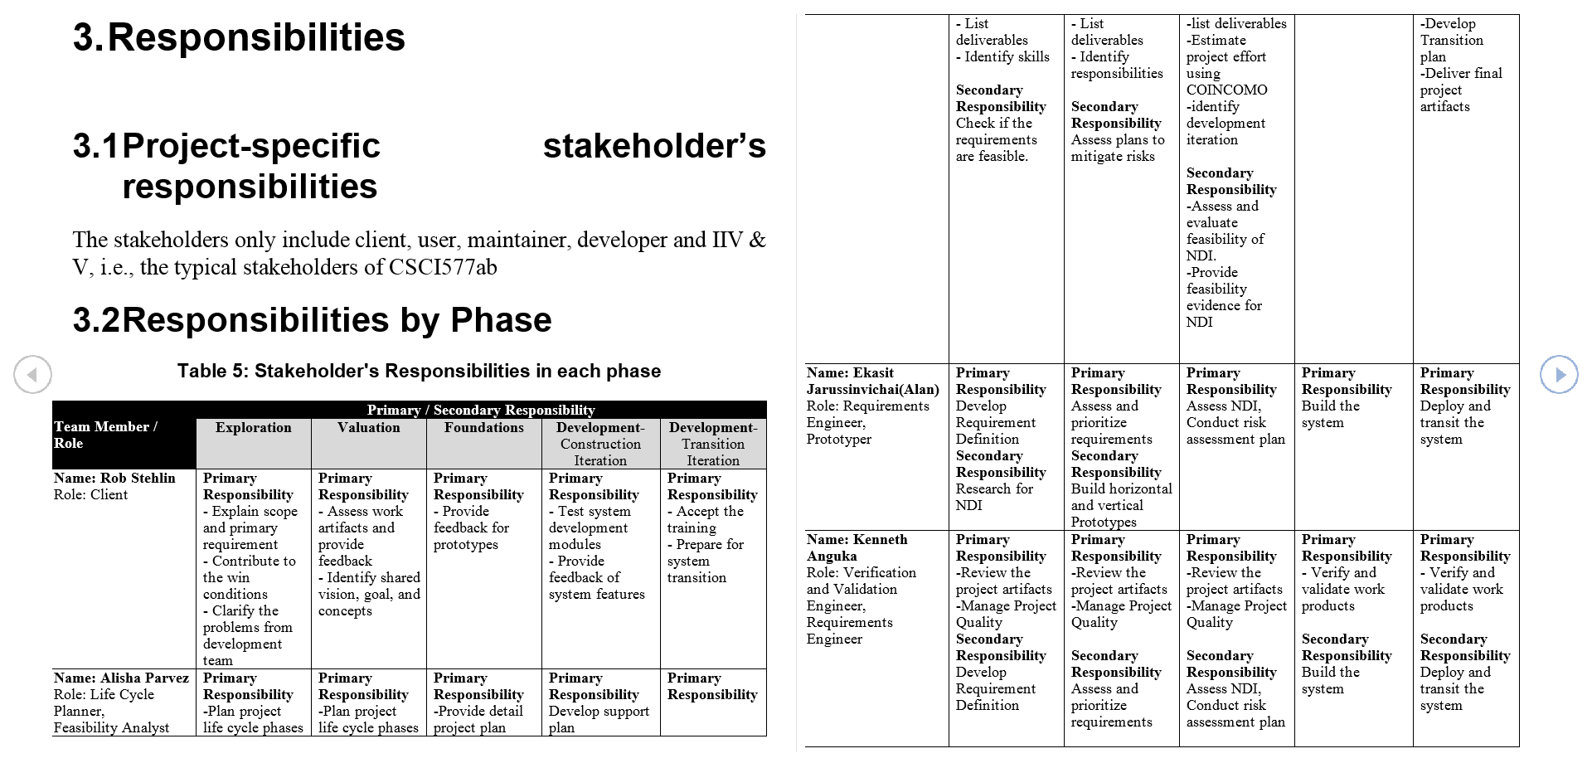
RESPONSIBILITIES

Slide 56
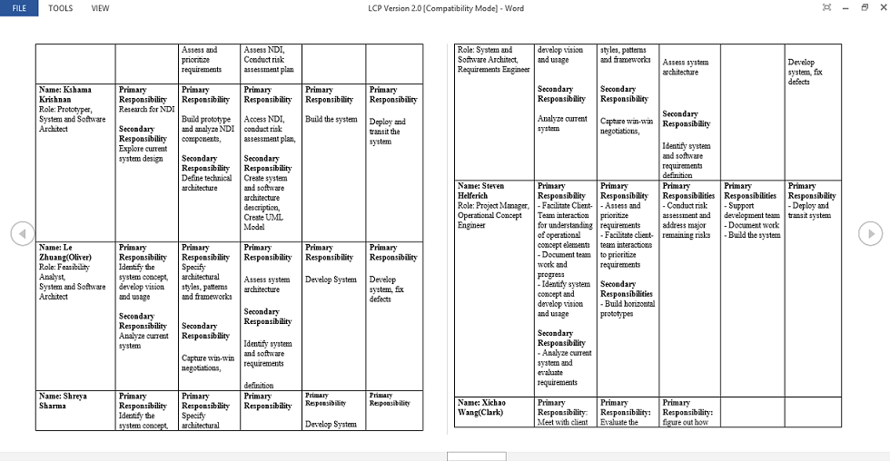

Slide 57
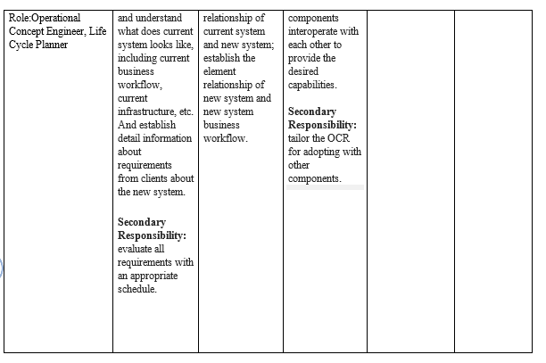

Slide 58
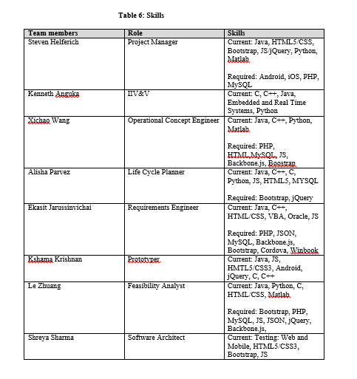
SKILLS

Slide 59
Approach
Monitoring and Control
-The effort spent on the project is being recorded on Bugzilla.
-The number of lines of code is logged on as project report every two weeks.
-Communication with the client is being done through Winbook and emails.
-Commitment review is done before moving into each phase.
The overall strategy is reported through project plan every two weeks.
Closed Loop Feedback Control
The team internally communicates through emails and google drive to keep everyone updated. The team also has team meeting every week to discuss about what we did in the previous week and what we are supposed to do next week.

Slide 60
Reviews
ARB: This is a review that we perform with instructors and TAs to analyze our project progress.
Team Meeting: Every Monday, the on-campus team has group meeting discussing about the progress and to-dos. The den-student is kept updated through mails and google drive documents.
Bugzilla: We have maintained Bugzilla to trace our progress

Slide 61
Methods, Tools and Facilities
TOOLS | USAGE | PROVIDER
Bugzilla | Tracks project progress | TA
Winbook | Keeps track of the information resulting from negotiations with client, win conditions and issues raised | TA
Microsoft Visio | Documents OCD workflow | Microsoft
Microsoft Office | Documents editing, sheets, presentations etc… | Microsoft
Visual Paradigm | Captures UML and auto generate SSAD | Visual Paradigm International
COINCOMO | Estimates the software developing cost | USC CSSE
Effort Report | Records the total weekly working hours on the project | USC CSSE
MPP | Makes the project plan | Microsoft
Project Report | Records lines of code | Microsoft
Balsamiq mockups | For prototyping | Balsamiq

Slide 62
Resources
The following conditions were used to estimate the cost of our system, CashDoctor 3.0 Mobile App.
This project has no budget for our development efforts, while the software is provided and tools are free.
The duration of the project is 12 weeks in CSCI577a
The duration of the project is 12 weeks in CSCI577b.
There are eight team members.
There are four modules in this system.
Search module
Share module
Capture module
Networking module
Programming language is JavaScript
The SLOC is estimated by prototyper

Slide 63
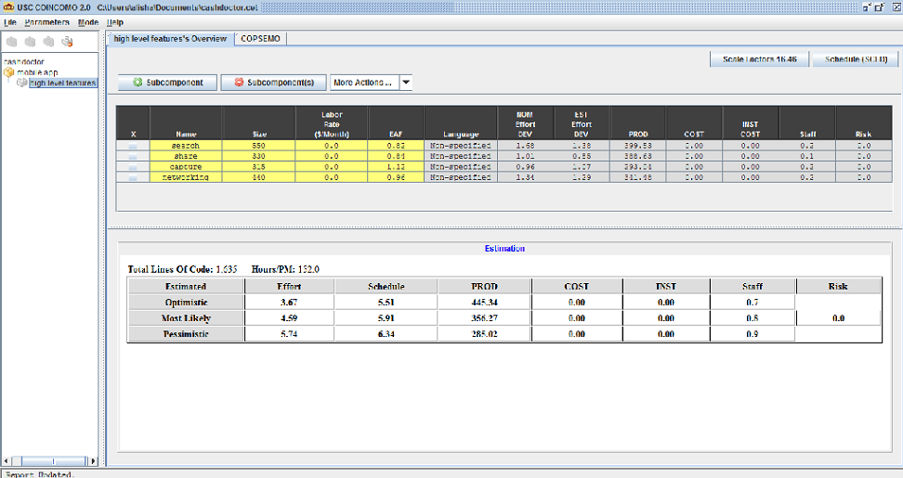
COINCOMO estimate

Slide 64
Feasibility Evidence Description

Slide 65
Process Feasibility
Criteria | Importance | Project Status
30 % of NDI/NCS features | 2 | 4
Single NDI/NCS | 1 | 1
Unique/ inflexible business process | 1 | 1
Need control over upgrade / maintenance | 1 | 1
Rapid deployment | 2 | 3
Critical on compatibility | 1 | 2
Internet connection independence | 1 | 1
Need high level of services / performance | 2 | 2
Need high security | 3 | 2

Slide 66
Process Feasibility (Cont.)
Criteria | Importance | Project Status
Asynchronous communication | 2 | 2
Be accessed from anywhere | 2 | 3
Critical on mass schedule constraints | 1 | 2
Lack of personnel capability | 1 | 3
Require little upfront costs | 1 | 3
Require low total cost of ownership | 1 | 3
Not-so-powerful local machines | 1 | 2

Slide 67
Major Risks
Risk | Potential Magnitude | Probability Loss | Risk Exposure
OCR Failure on Mobile Platform | 4 | 10 | 40
Back-end Incompatibility | 7 | 9 | 63
Platform Inconsistency | 7 | 8 | 56
Performance Limitation | 6 | 9 | 54
Scalability Uncertainty | 6 | 8 | 48
Personal Time Constraints | 7 | 8 | 56
Client Time Constrains | 6 | 6 | 36
Team Cohesion Failure | 4 | 9 | 36

Slide 68
NDI Feasibility
Google Map
Google, Proprietary,mature,
bootstrap, jQuery, Backbone.js
Open source
Java OCR
Open source community
Tesserate OCR
Google, open source

Slide 69
Tesserate OCR vs Java OCR
NDI attributes | Weight | Java OCR | Tesserate OCR
Functionality | 20 | 16 | 17.5
Maturity of product | 25 | 13.5 | 19.25
Flexibility | 15 | 10.25 | 12
Ease of use | 25 | 18.5 | 18.25
Inter-component Compatibility | 15 | 11.75 | 2.25
Total | 100 | 70 | 69.25

Slide 70
Capability Feasibility
CR-1: Acquire Geographic Location
CR-2: Display Price
CR-3: OCR
CR-4: Post Price
CR-5: Input Price Manually

Slide 71
Personnel Cost
Activities | Time Spent (Hours)
Exploration, Valuation and Foundation Phase (12 weeks)
Client meetings [2 hrs/week * 12 weeks * 1 person] | 24
Client Win-win sessions [2 hrs/session * 2 sessions * 1 person] | 4
Prototyping Presentation [1 hr * 1 person] | 1
Architecture Review Boards [2hrs * 1 person] | 2
Subtotal | 31

Slide 72
Personnel Cost
Activities | Time Spent (Hours)
Exploration, Valuation and Foundation Phase (12 weeks) | 31
Development and Operation Phase (12 weeks)
Client meetings [4 hrs/week * 12 weeks * 1 person] | 48
Client training seed users [2 hrs/week * 12 weeks * 1 person] | 24
Architecture Review Boards [2 hrs * 1 person] | 2
Performing core capabilities drive-through [2 hrs * 1 person] | 2
Subtotal | 76
Maintenance Period (Annual)
Promoting the app [2 hrs/week * 52 weeks] | 104
Subtotal | 104
TOTAL | 211

Slide 73
Hardware/Software Cost
Type | Cost($/year)
Development Cost
Test Cell Phones | 1200
iOS developer license | 99
Operational Cost
Web hosting | 1000
Transition Cost
Total | 2299

Slide 74
Revenue
$600 Billion Health Care in US
Userbase Assumption:
Year | Optimistic | Conservative
2015 | 50,000 | 25,000
2016 | 100,000 | 50,000
2017 | 200,000 | 100,000

Slide 75
Revenue (cont)
Benefit Assumption: Benefit = $600 billion * (userbase / population of US) * 5%
Revenue Assumption: Revenue = $600 billion * (userbase / population of US) * 5% * 15%
Year | Optimistic | Conservative | Optimistic | Conservative
2015 | 5,000,000 | 2,500,000 | 750,000 | 375,000
2016 | 10,000,000 | 5,000,000 | 1,500,000 | 750,000
2017 | 20,000,000 | 10,000,000 | 3,000,000 | 1,500,000

Slide 76
Revenue (cont)
Year | Cost | Benefit (con) | Benefit (opt) | ROI (con) | ROI(opt)
2014 | 2299 | 0 | 0 | -1 | -1
2015 | 2000 | 375000 | 750000 | 86 | 173
2016 | 4000 | 750000 | 1500000 | 134 | 270
2017 | 8000 | 1500000 | 3000000 | 160 | 321

Slide 77
Quality Management Plan

Slide 78
Traceability Matrix
OC-1 Manual Information Search | WC_3084 | UC4: Search healthcare information
OC-2 Geo-Location Search | WC_3084 WC_3094 | UC4: Search healthcare information
OC-3 Price Comparison | WC_3090 | UC12: Customer can compare medical price information
OC-4 User Registration | WC_3086 | UC1: Create/Login customer profile UC8: Create/Login Provider profile
OC-5 Price Sharing | WC_3083 WC_3082 | UC3: Prices shared by the customers UC9: Provider shares Healthcare Information
OC-6 Provider Rating | WC_3089 WC_3091 | UC11: Customer can rate/review a provider
OC-7 Networking | WC_3088 | UC5: Create a network UC6: Join an existing network
OC-8 Profile Management | WC_3187 | UC2: Update customer Profile
OC-9 Notification Management | WC_3098 WC_3095 | UC7: Get notified based on the network subscribed for

Slide 79
Quality Management Strategy
Project Manager and IIV&V reviews all Bugzilla tasks on a weekly basis.
Report is emailed to the team.

Slide 80
Defect Identification Reviews
Documents are reviewed by IIV&V and Project Manager prior to closing a task
Mostly task tracking, but will become bug tracking by Spring 2015 semester
Currently:
0 CONFIRMED
4 IN_PROGRESS
16 RESOLVED

